Slide 1

Sharpening the Saw:
Trust Series
The following posts appeared on my social media accounts for a week. If you missed those posts, each one is listed here. I recommend that you think about your trust issues with self, others, and God as you read the post either one a day for six days or all six in one day. At the end of the slide is a bonus not posted on social media. Enjoy!
www.angelahooks.com

Slide 2


Slide 3
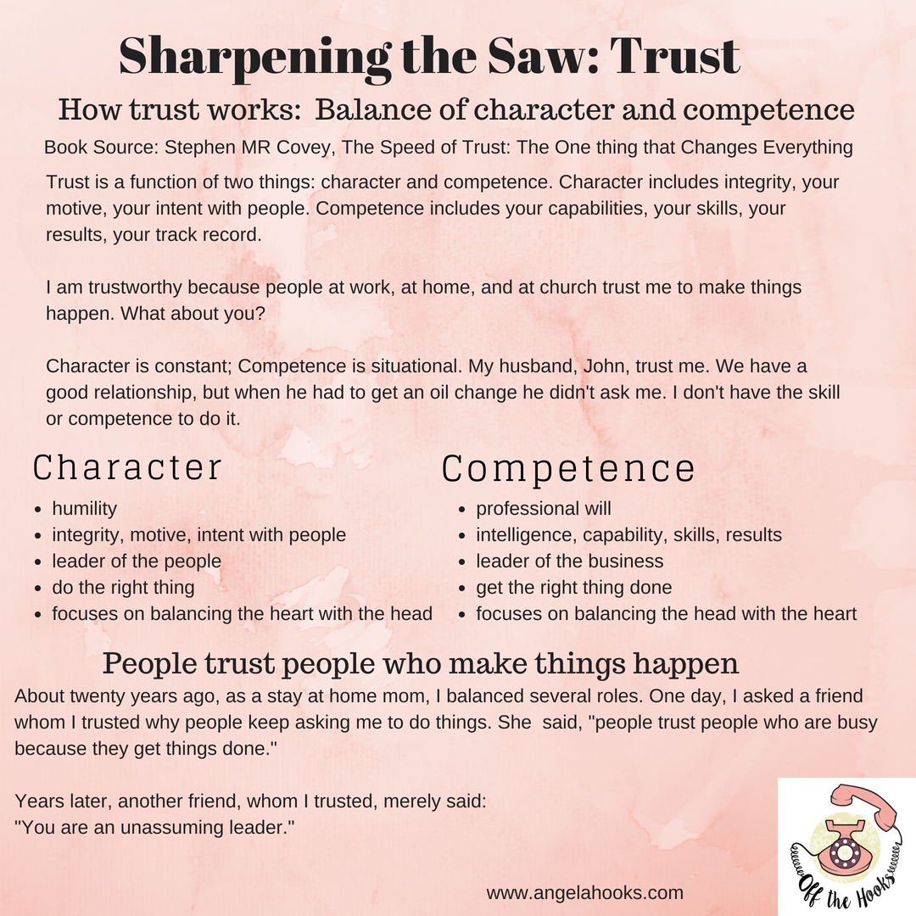

Slide 4
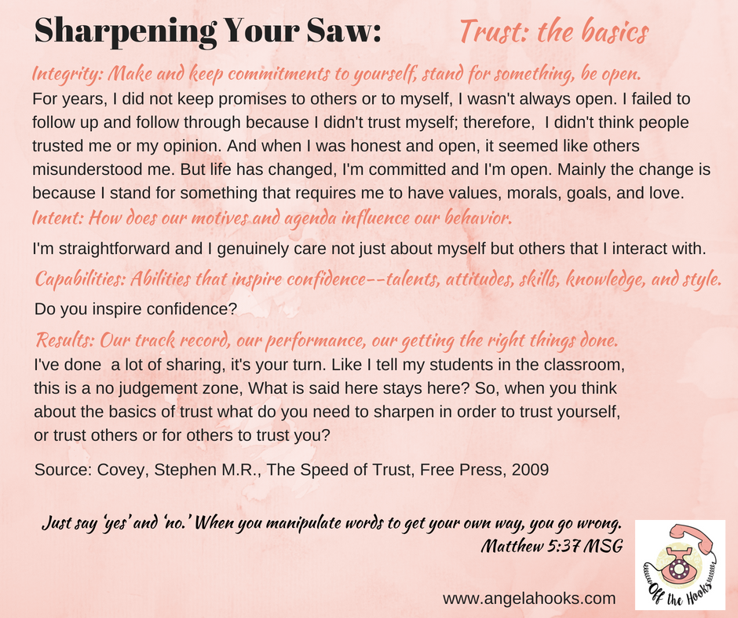

Slide 5
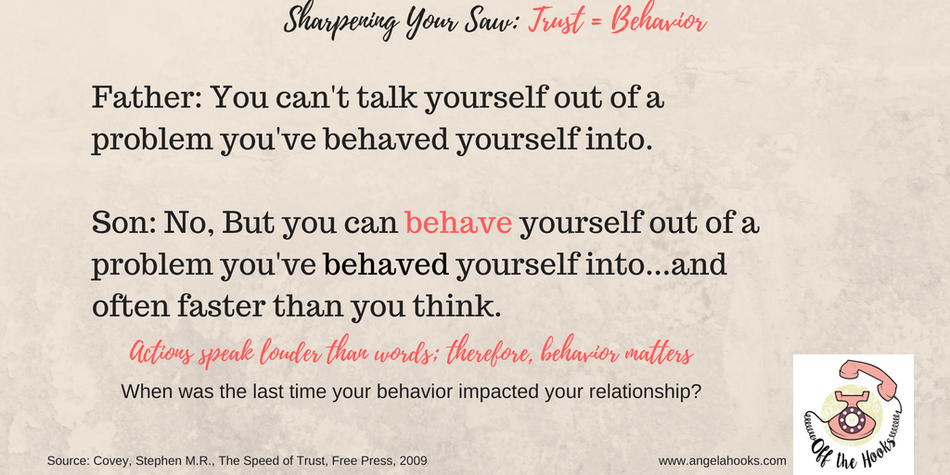

Slide 6
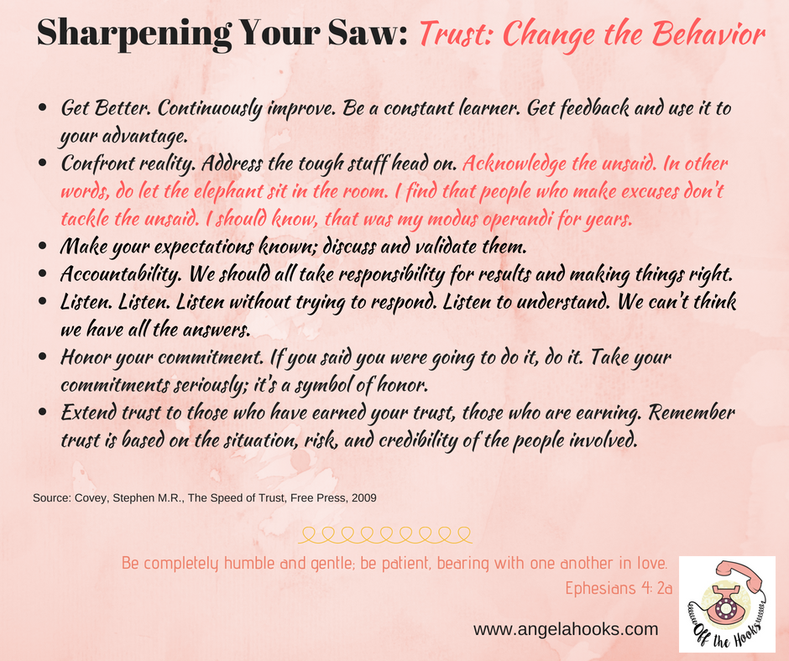

Slide 8
